Slide 1

NIST Information Technology Laboratory Query Disambiguation via Answer-Free Context: Doubling Performance on Humanity’s Last Exam

Slide 2
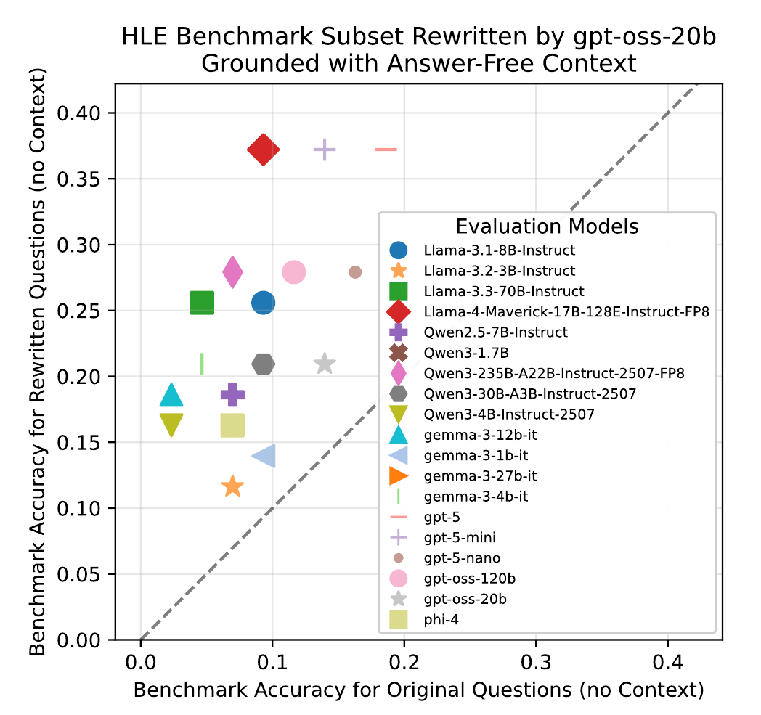
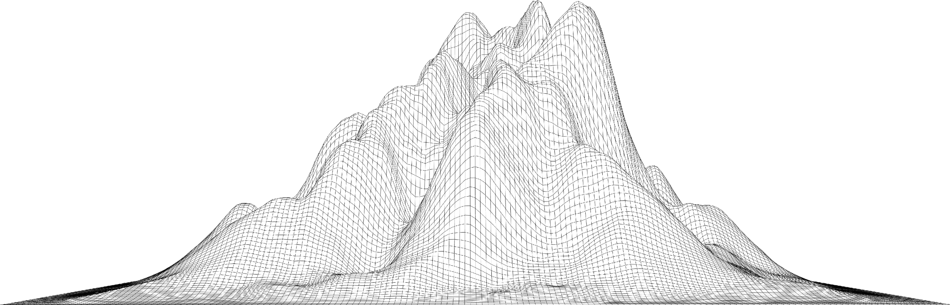
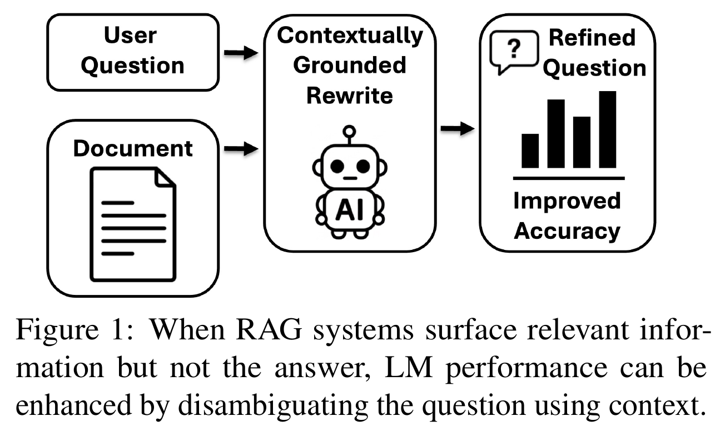

Performance Uplift from Question Disambiguation
Using background information sans answer, I can double your model’s accuracy on Humanities Last Exam
2

Slide 3

3

Slide 4

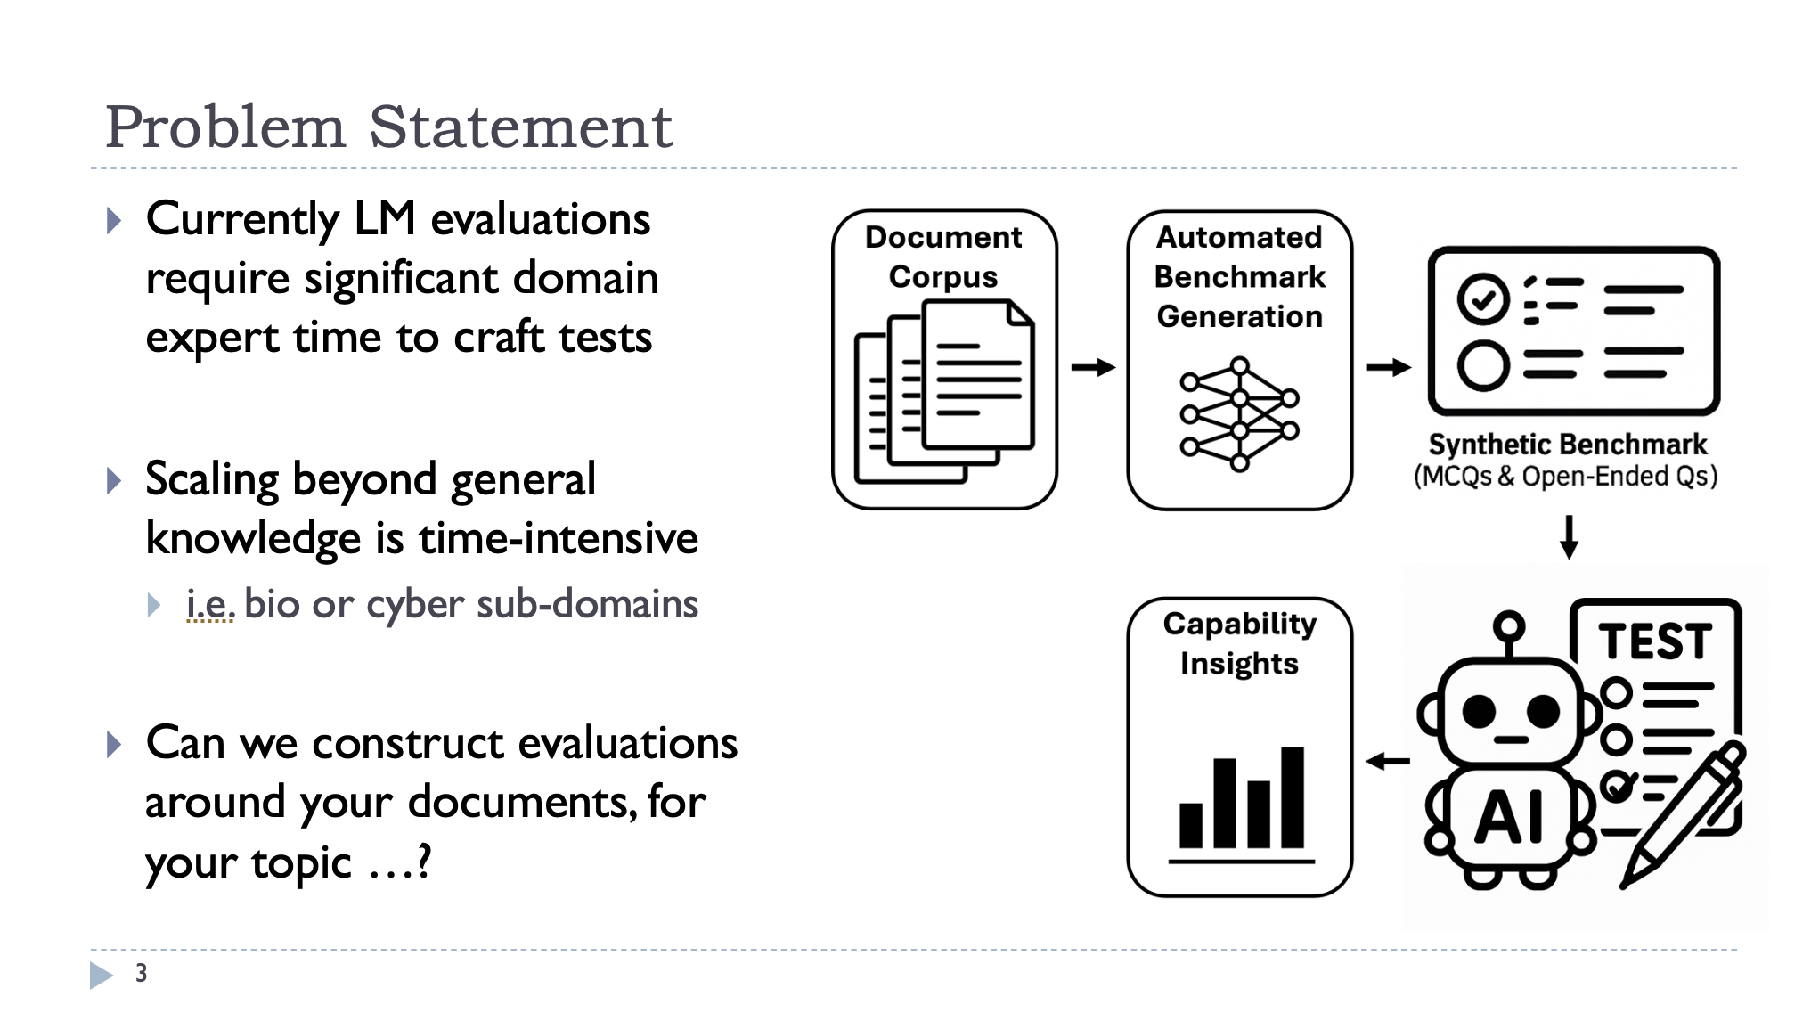
When Last We Spoke
4

Slide 5
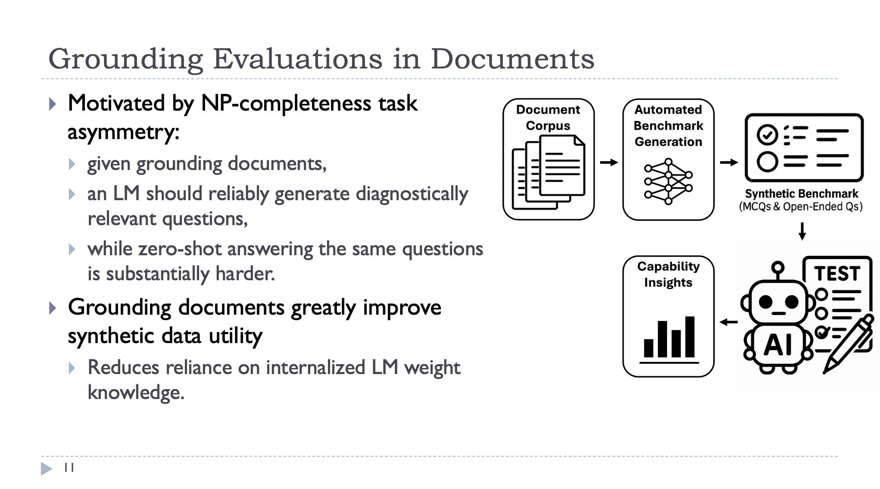
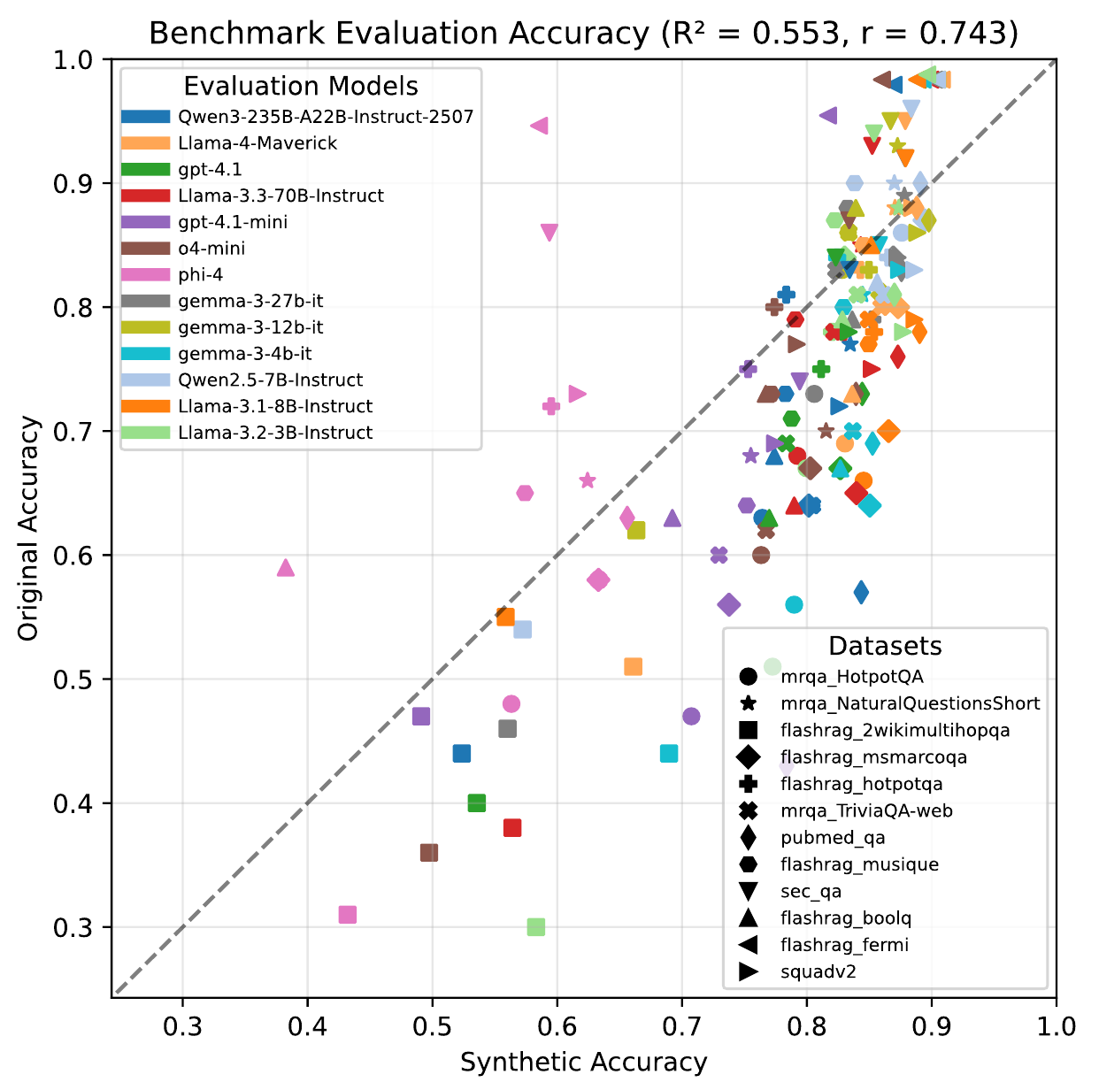
Generative Benchmarking
5

Slide 6
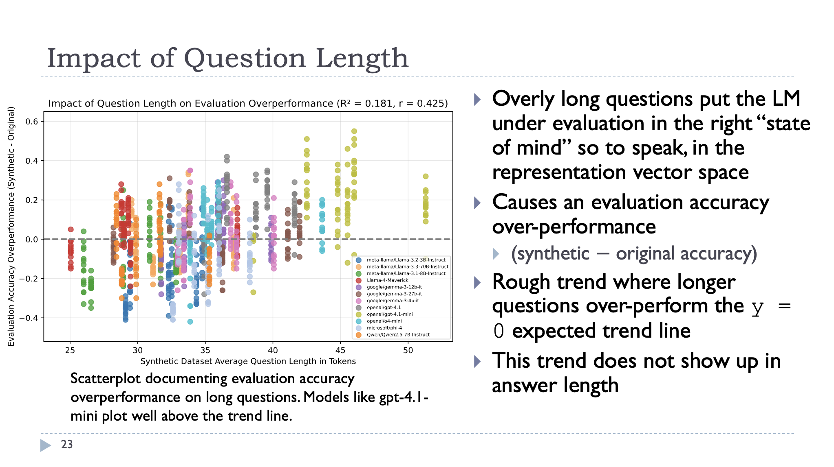
But Long Questions Overperform… Why?
6

Slide 7
Background
LM users often implicitly assume the LM shares their mental model, including their background knowledge, context, and intent.
This can cause them to omit critical background and related information when formulating a query, believing it to be self-evident.
For example: “How big is the country?”
… which country
7

Slide 8
Background
While LMs undeniably possess considerable general knowledge; they can struggle with domain-specific or proprietary data absent from public training sets.
In professional and enterprise workflows, system performance depends on Retrieval-Augmented Generation (RAG) to dynamically construct context for the LM based upon user queries [1, 2].
Current RAG evaluation focuses on retrieval ranking [3, 4] rather than how models utilize retrieved documents.
A particularly critical component, with a long history in information retrieval, is the transformation, expansion, and normalization of the users query [5].
[1] https://arxiv.org/abs/2005.11401
[2] https://arxiv.org/abs/2407.02485
[3] https://arxiv.org/abs/2406.04744
[4] https://arxiv.org/abs/2408.08067
[5] https://arxiv.org/pdf/1903.11783
8

Slide 9
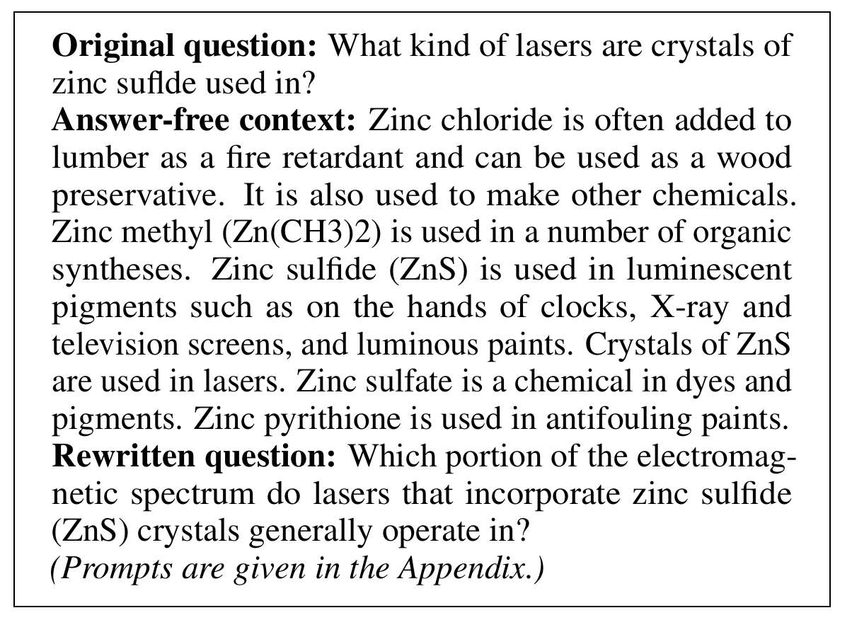
Answer Free Context (i.e. the background information)
Example HLE Datapoint
Original question,
Associated Answer-Containing Context
Associated Answer-Free Context (AFC), and
LM Rewritten question
RAG system could return b) or c), and you don’t know which you got
9

Slide 10
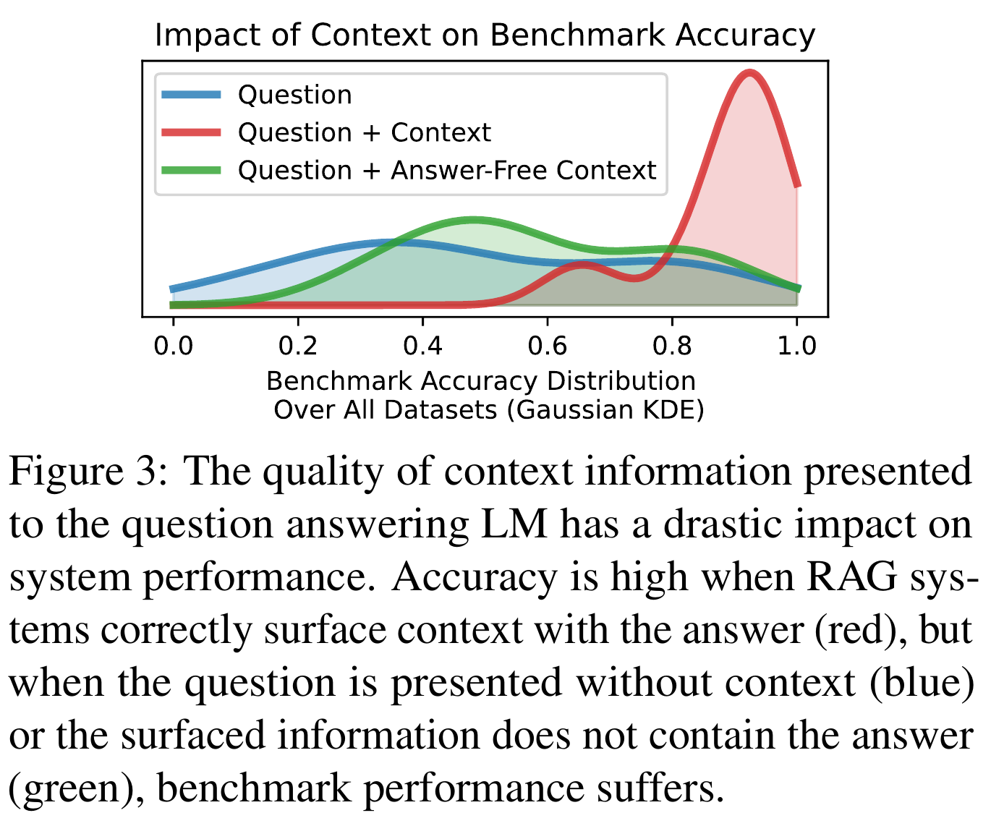
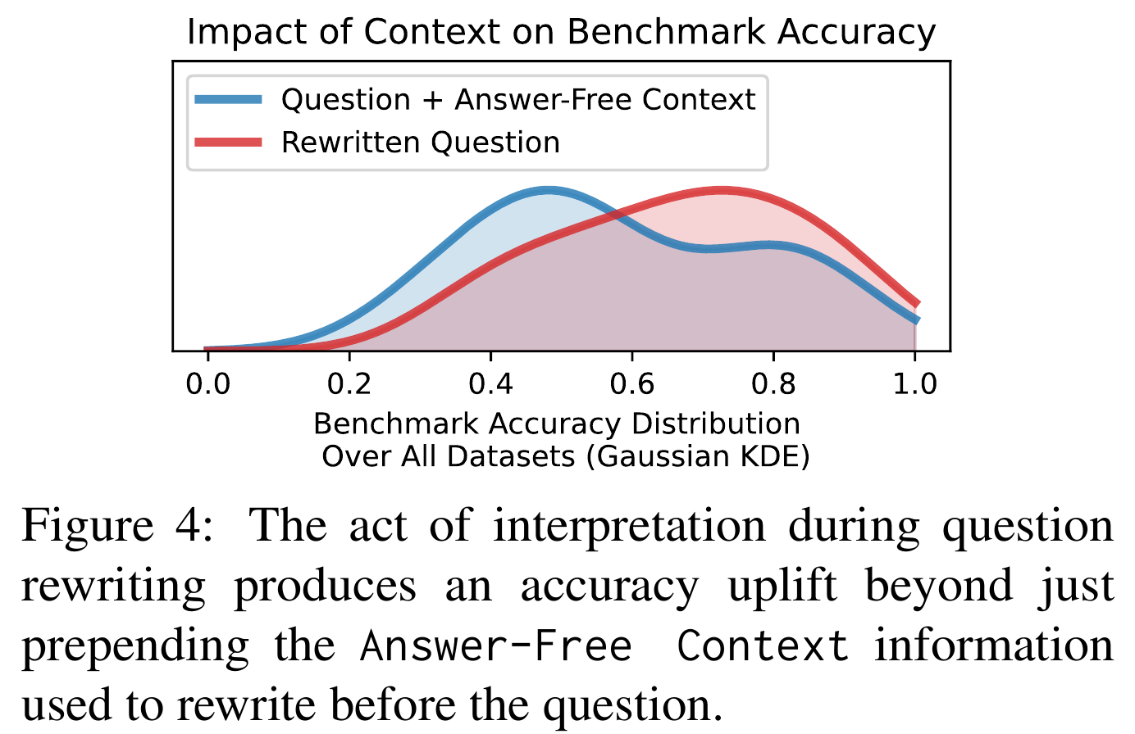
Approaches for Asking Questions of an LM+RAG System
10

Slide 11
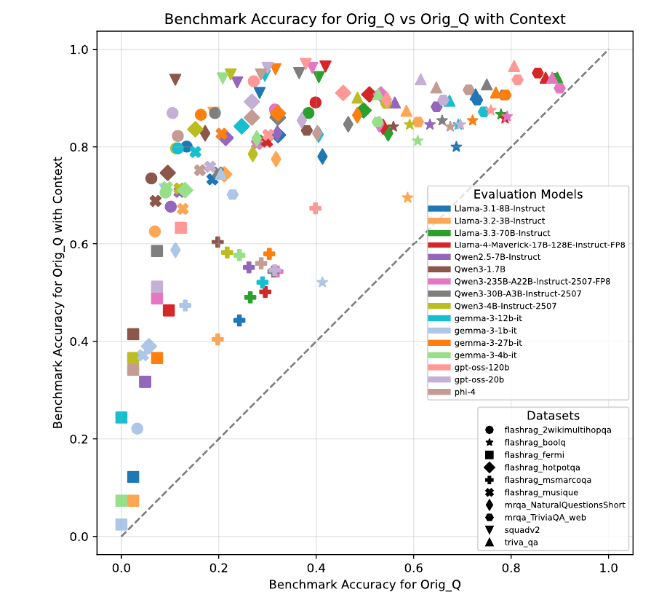
Validating Context Utility
Scatterplot of benchmark accuracy values
X: original question accuracy
vs
Y: original question prepended with the answer-containing context
Prepending the answer containing context produces significant over-performance
Logical as the model is now getting an open-book test
11

Slide 12
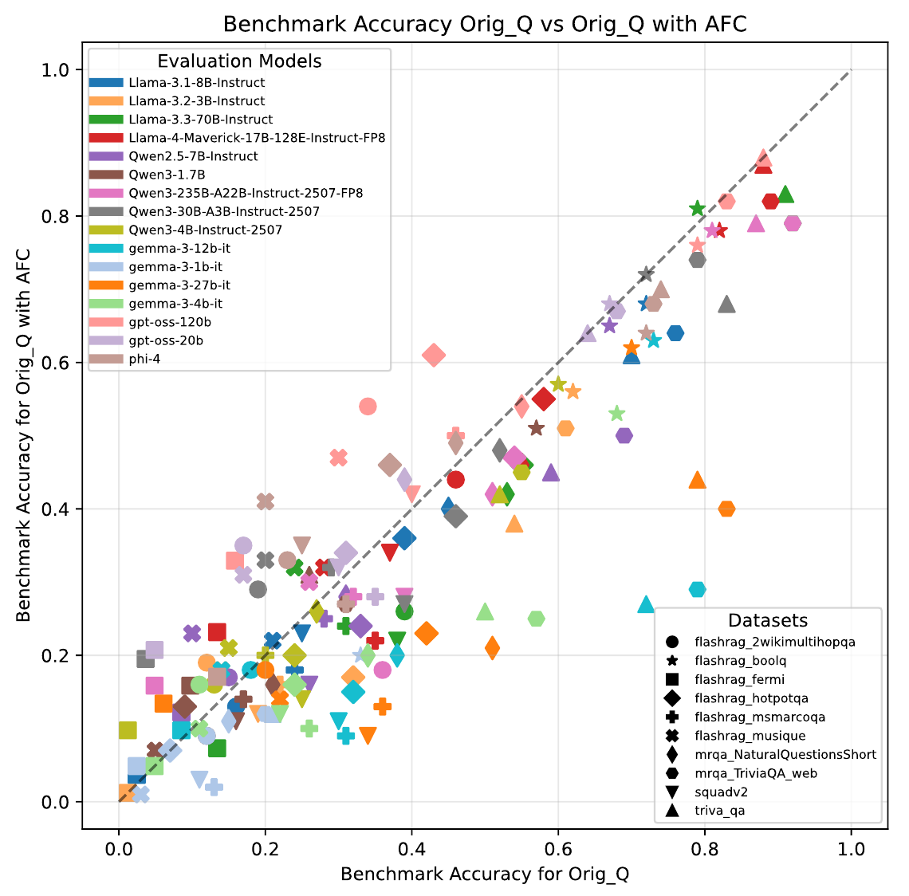
Validating Answer-Free Context
Scatterplot of benchmark accuracy values
X: original question accuracy
vs
Y: original question prepended with the answer-free context
Prepending the answer-free context produces no significant uplift
Test remains closed book despite the additional background information
12

Slide 13
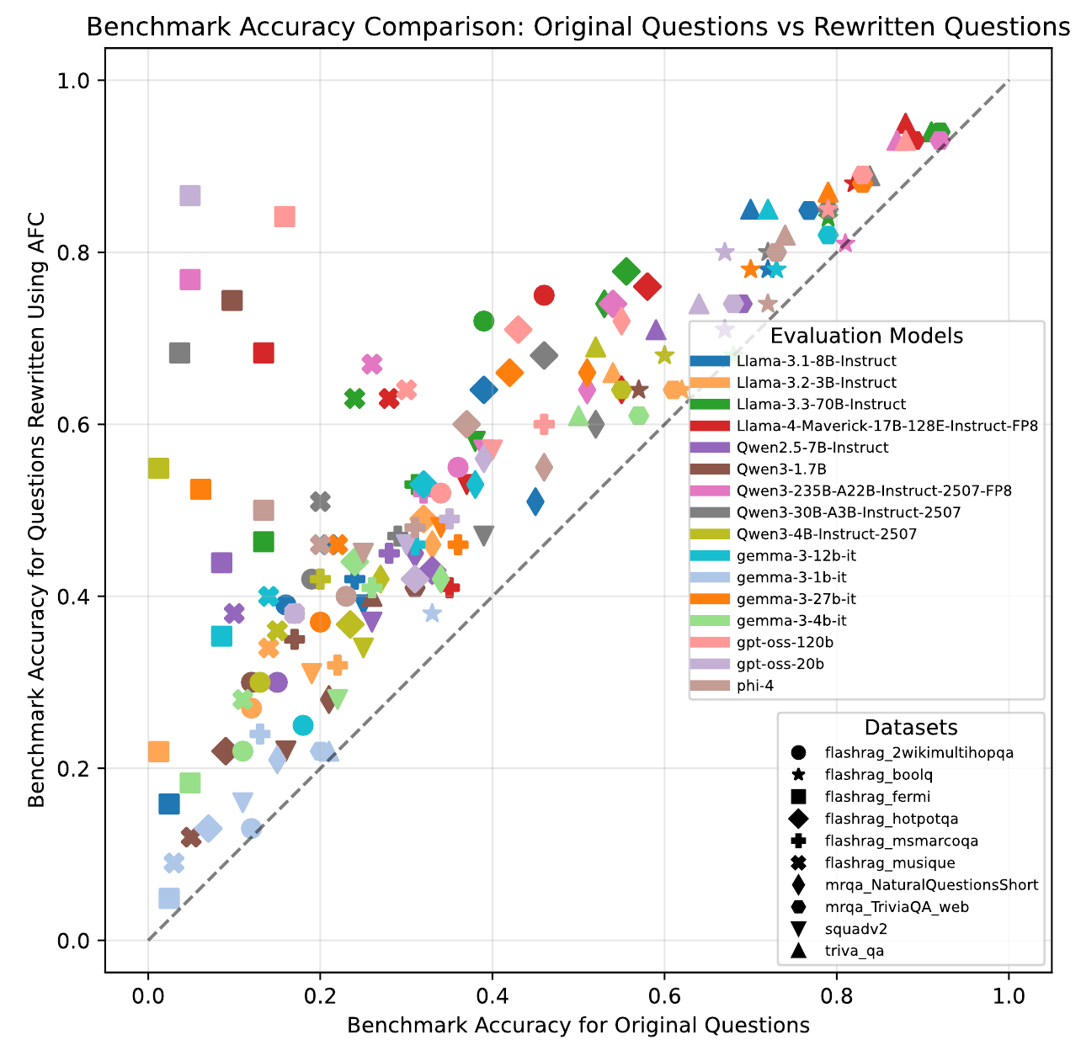
Question Rewriting
Scatterplot of benchmark accuracy values
X: original question accuracy
vs
Y: rewritten question (using AFC) accuracy
Rewriting the question using answer-free context before posing it to the LM provides a moderate uplift in accuracy
13

Slide 14
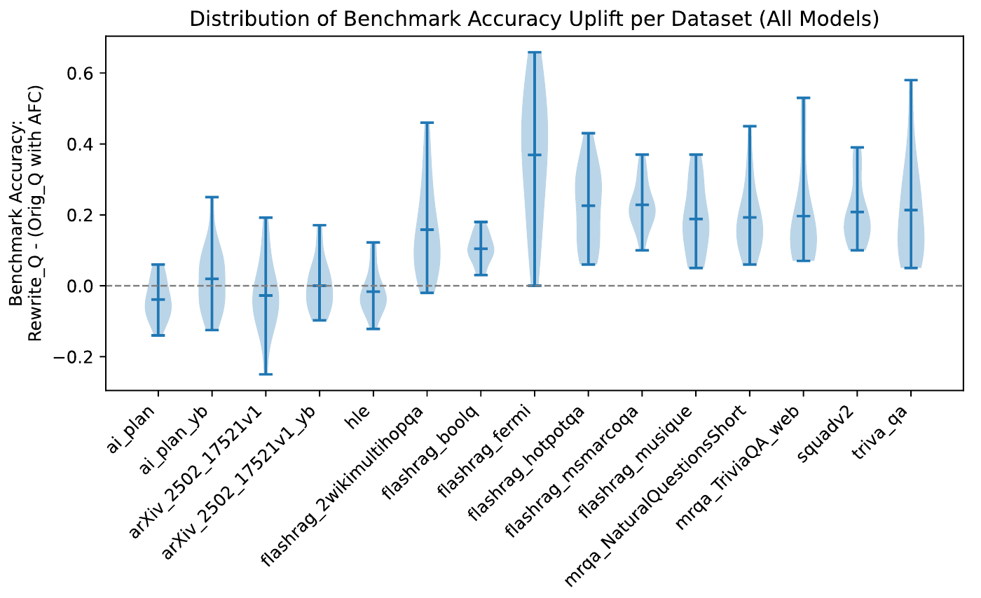
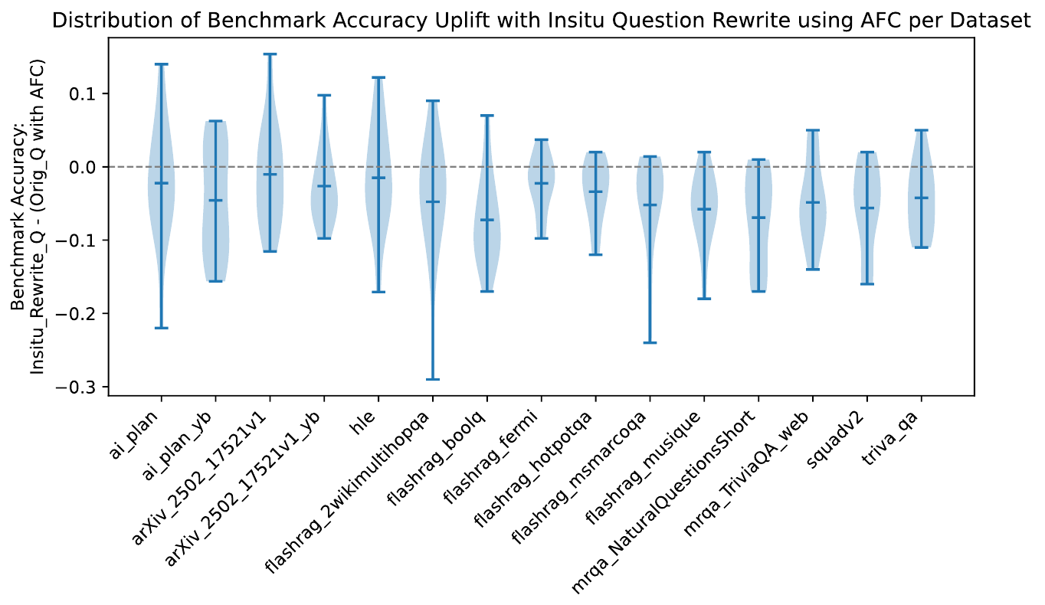
A Separate Rewriting Phase is Required
14

Slide 15
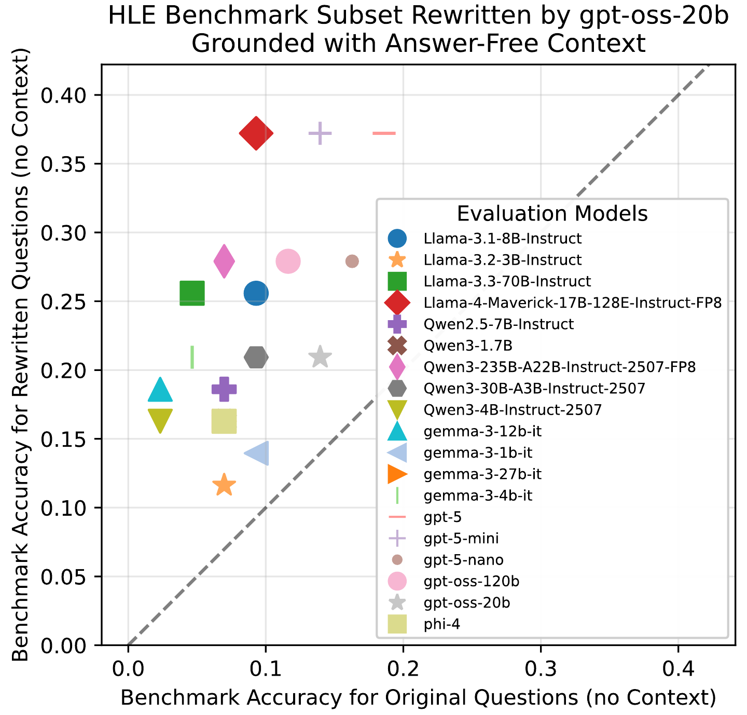
gpt-5-mini HLE Accuracy: 0.14 -> 0.37
15

